Slide 1
basic elements of python

Slide 2
Objects
Objects are the core things that Python programs manipulate.
Every object has a type that defines the kinds of things that programs can do with objects of that type.

Slide 3
Identifiers in Python
Identifier is a user-defined name given to a variable, function, class, module, etc. The identifier is a combination of character digits and an underscore.
They are case-sensitive i.e., ‘num’ and ‘Num’ and ‘NUM’ are three different identifiers in python.
It is a good programming practice to give meaningful names to identifiers to make the code understandable.

Slide 4
Rules for Naming Python Identifiers
It cannot be a reserved python keyword.
It should not contain white space.
It can be a combination of A-Z, a-z, 0-9, or underscore.
It should start with an alphabet character or an underscore ( _ ).
It should not contain any special character other than an underscore ( _ ).
Examples:
Valid identifiers:
var1
_var1
_1_var
var_1
Invalid Identifiers
!var1
1var
1_var
var#1
var 1

Slide 5
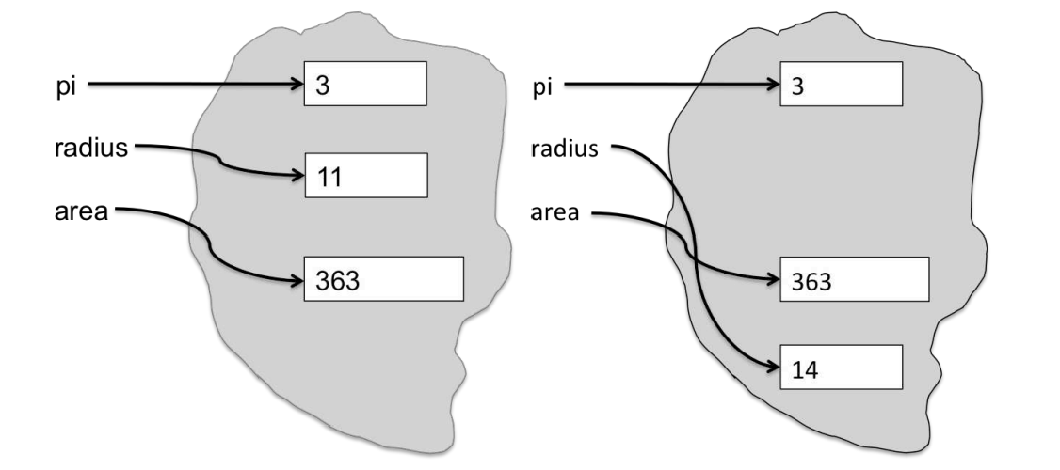
Python Variable
Variables provide a way to associate names with objects.
They are containers that store values.
Once an object is assigned to a variable, it can be referred to by that name.
Binding of variables to objects

Slide 6
Python Keywords
Keywords in Python are reserved words that have special meanings and serve specific purposes in the language syntax.
Python keywords cannot be used as the names of variables, functions, and classes or any other identifier.
Getting List of all Python keywords
import keyword
# printing all keywords at once using "kwlist()"
print("The list of keywords is : ")
print(keyword.kwlist)

Slide 7
Category of Keywords
Category | Keywords
Value Keywords | True, False, None
Operator Keywords | and, or, not, in, is
Control Flow Keywords | if, else, elif, for, while, break, continue, pass, try, except, finally, raise, assert
Function and Class | def, return, lambda, yield, class
Context Management | with, as
Import and Module | import, from, as
Scope and Namespace | global, nonlocal
Async Programming | async, await

Slide 8
Comments in Python
Comments in Python are the lines in the code that are ignored by the interpreter during the execution of the program.
Also, Comments enhance the readability of the code and help the programmers to understand the code very carefully.
Example:
# USE # for adding comments
# This is Python Comment
Multi line comment : It is useful when we need to comment on many lines. In python, triple double quote(“ “ “) and single quote(„ „ „)are used for multi-line commenting.

Slide 9
Literals
Literals can be defined as data that is given in a variable or constant. The values can be a number, character, string or boolean values.
Types of Literals:
Numeric literals: Numeric literal are immutable(can't be changed) and it can be an integer , float and complex values.
Eg: x=156
y=100.45
String literals : String literal are enclosed with in quotes. we can use either single or double.
Eg: 'hi', ''welcome‘’
Boolean literal : can have only two values either true or false.
Special literal : Python has only one special literal called ''none‘’.
Literal collection : Literal collection segment to specify values for a collection data type.

Slide 10
Thank You

